Slide 1
Winging it: My neurodivergent Non-technical journey into data

Slide 2
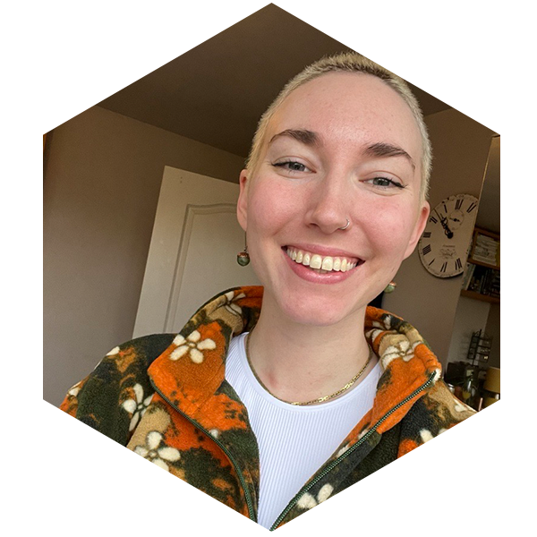
Who am i?
Isi Turner – they/them
Marketing Executive at Advancing Analytics
Over 3 years marketing experience in Data/AI
Non-binary
Non-technical
Neurodivergent
Not a doctor!
Notes:
Name, pronouns, job title. I have over 3 years marketing experience in data/AI and it’s also my third time here at SQLBits, a conference I love, and particularly loved the theme last year as a D&D nerd myself.
I’m non-binary, non-technical and neurodivergent – the latter two are obviously the focus of this talk
I am also not a doctor! This is not medical advice – it’s purely anecdotal, with an aim to help support neurodivergent people in the workplace.

Slide 3
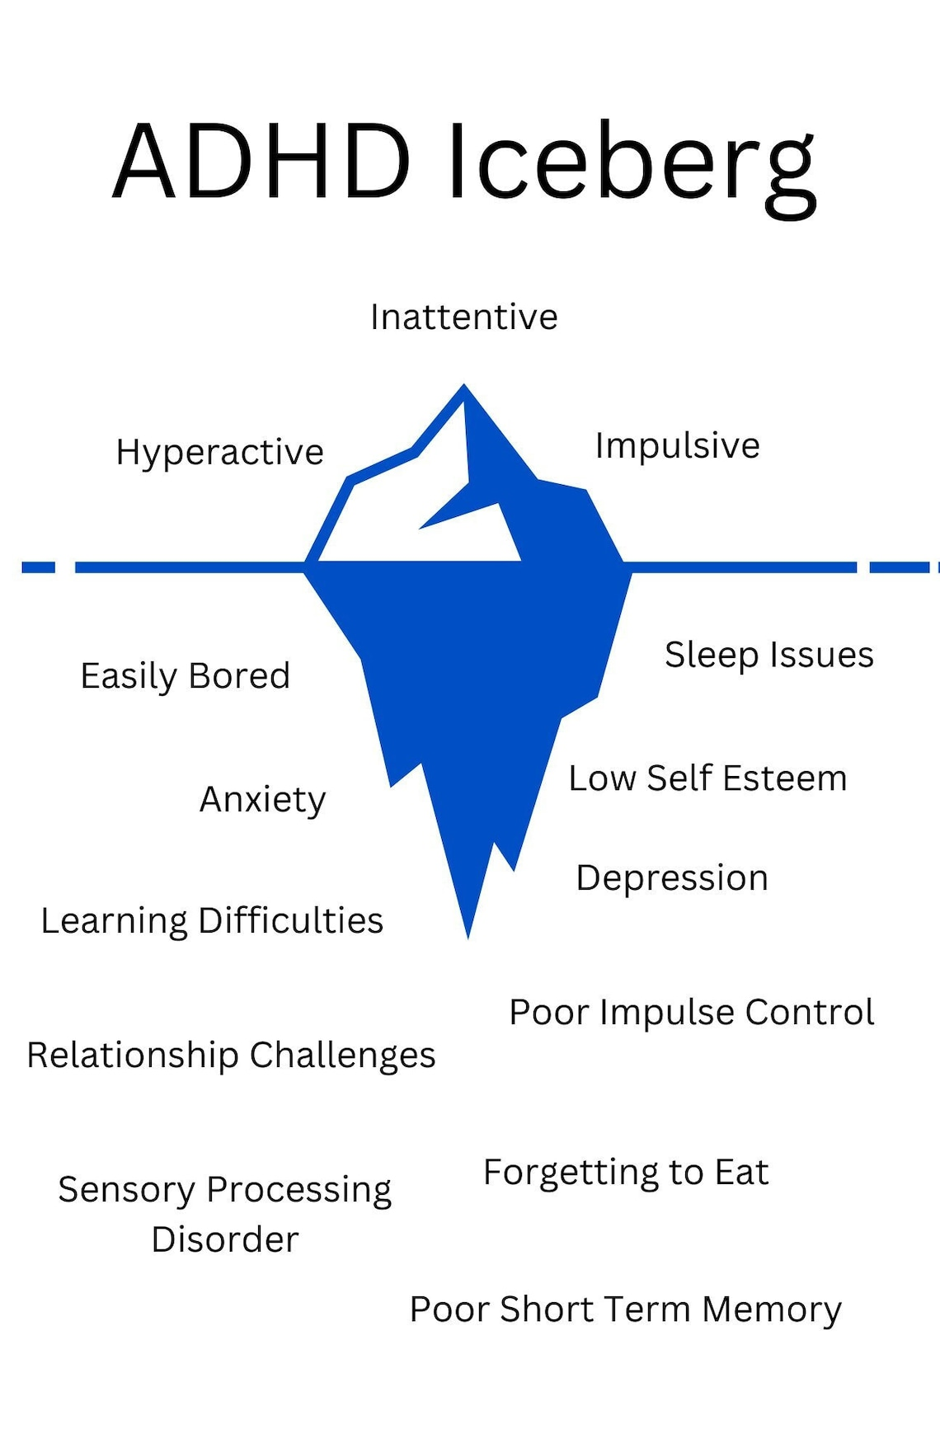
Why now?
Boom of people realising they’re neurodivergent
Pandemic:
Working from home, no routine
Lower level of dopamine-inducing activities
Notes:
The past few years has seen a boom of individuals realising they’re neurodivergent – in particular that they have autism or ADHD – and I’m part of that boom. There’s lots of reasons for this, but one of the biggest is the pandemic. The shift to working from home, combined with the upheaval of routine and decrease of dopamine-inducing activities led many people to have a lightbulb moment.

Slide 4
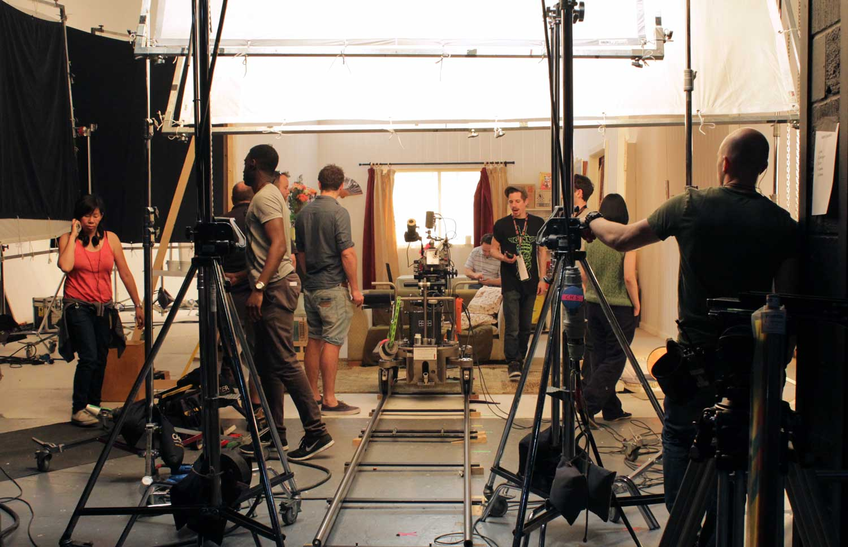



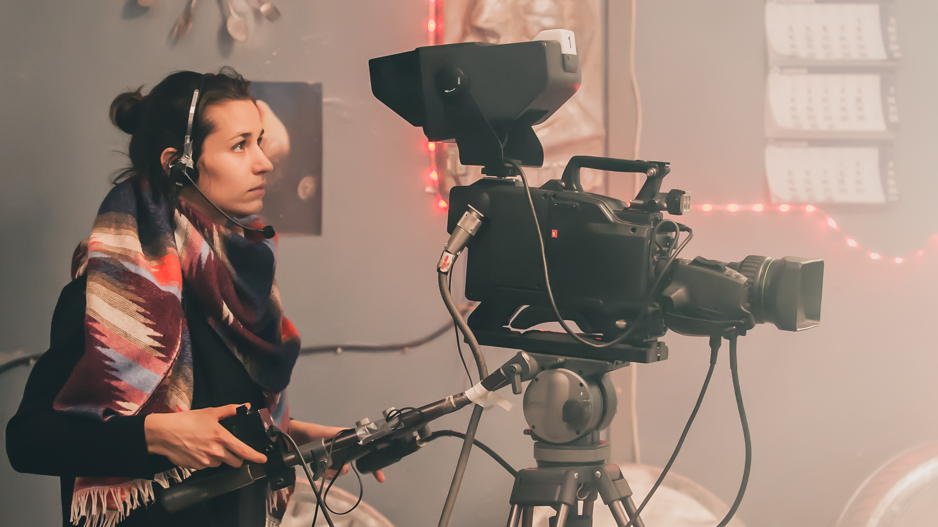
My Journey
Notes:
My journey begins back in 2020, when I was completing my degree in Film and English Lit. I had aspirations! I wanted to work in TV, on set as a runner, or on location, maybe working my way up to camera work!
I got one IMDB credit before Covid hit.
Everyone was out of work, or on a skeleton crew where runners weren’t hired. I didn’t know how long the pandemic was going to affect my job prospects in an already saturated and highly competitive job market. With bills to pay, I tried to figure out what I could do with my skillset, especially as hospitality had come to a standstill.
Intro: marketing. I fell into the job, and consequently into the world of data consulting. I’m incredibly grateful for my first workplace for taking a chance on someone with zero marketing qualifications or experience, and for supporting me as I grew. After a couple of years, I moved to my current position. I was upfront with wanting to work in TV and they were willing to support me with my dreams – until I realised that I didn’t actually want to work in TV anymore, about 6 months into the role.

Slide 5
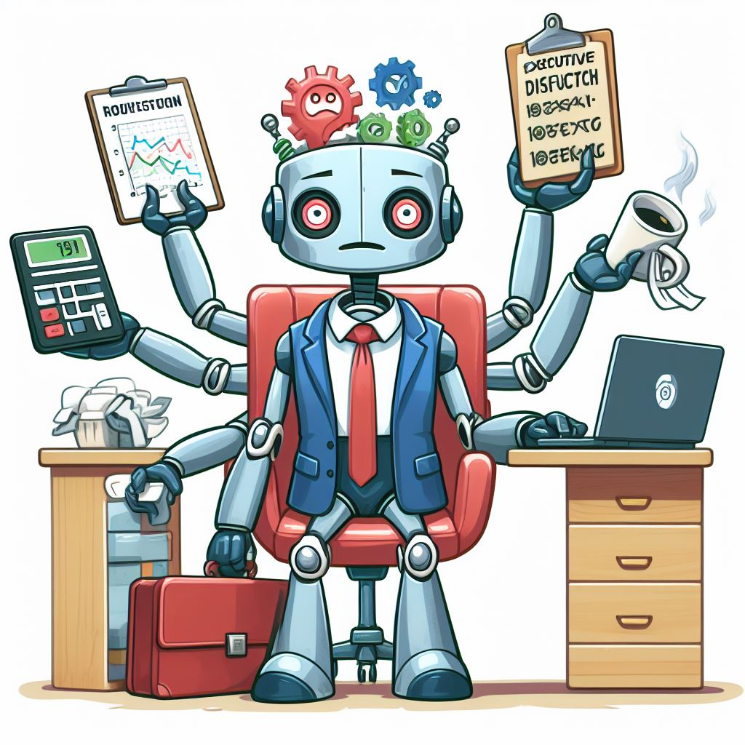
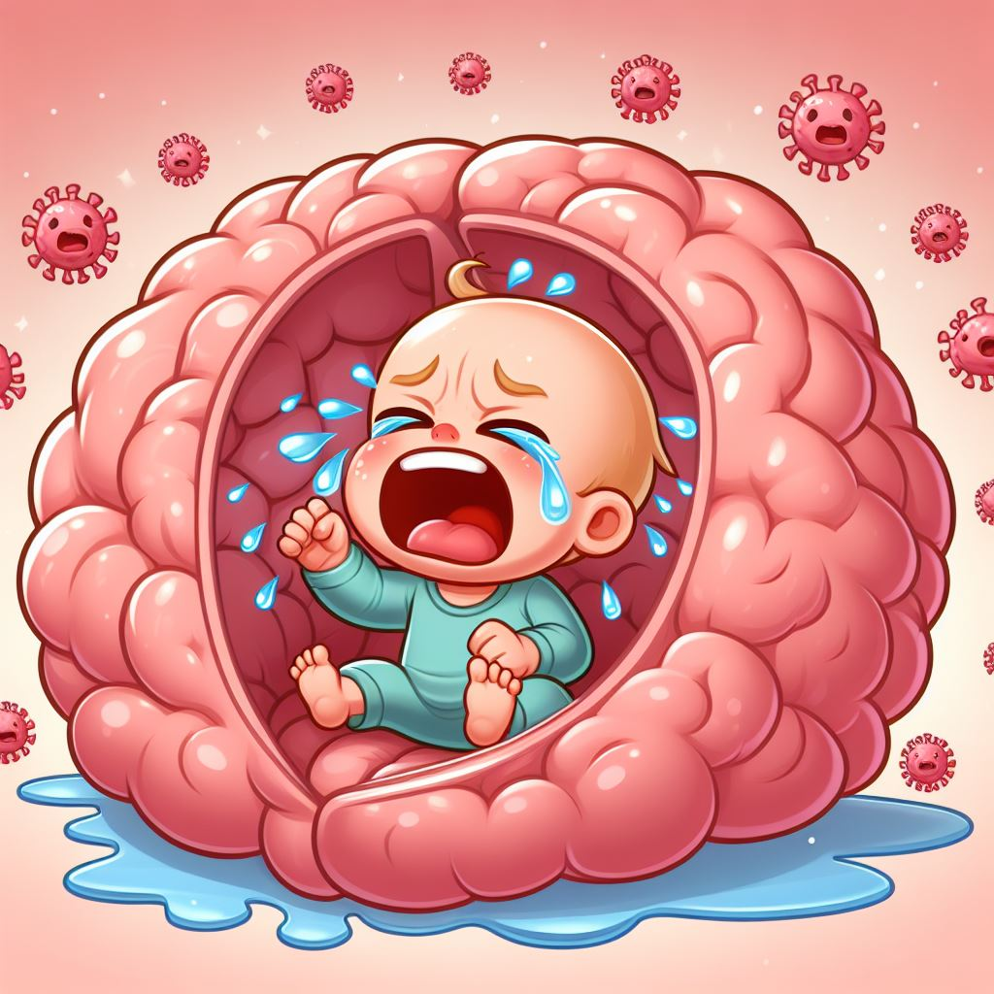
Non-technical and Neurodivergent
“When you’ve met one neurodivergent person, you’ve met one neurodivergent person”
Executive dysfunction
‘Toddler in my brain’
Notes:
Moving on to the main focus of this talk – being neurodivergent and how that works well with being non-technical in tech. I’m going to focus on ADHD as it’s my personal experience, and I am going to generalise a fair bit, but please remember the saying ‘when you’ve met one neurodivergent person, you’ve met one neurodivergent person’. If you work with a neurodivergent person, ask them what support they need.
With ADHD, there are many ways it shows up in my working life. I have combined ADHD, which means I have hyperactive and inattentive symptoms, so I’ve got the main ways each side affects my work.
Executive dysfunction is the inattentive side. It’s the inability to perform executive functions – this can look like forgetting to eat, go to the bathroom, and ‘procrastinating’, which isn’t procrastinating, but is actually ADHD paralysis. For me, I will listen to music and daydream, or get caught in a doomscrolling cycle. It’s incredibly difficult to break out of ADHD paralysis, and isn’t as simple as simply stopping. It takes more strength than you imagine to pull yourself out of ADHD paralysis, and some of the hacks I’m going to be talking about will hopefully help this.
For the hyperactive side, the ‘toddler in my brain’ analogy is one I use to describe how busy my brain can get. I need to make sure this toddler is fed and distracted and happy before I can focus on my task at hand. If it’s hyperactive or tired, I have no chance of focusing, whether this is because my brain is too busy and too loud – the hyperactive side.
All in all, I’ve learnt that working with my brain instead of against it was paramount to my success in the workplace. There is no point trying to work in a neurotypical way, when my brain literally, physically, isn’t wired that way.

Slide 6
Non-technical and Neurodivergent
INCUP:
Interest
Novelty
Challenge
Urgency
Passion
Notes:
INCUP is an acronym developed by a psychologist to describe 5 ways that an adult with ADHD can stay motivated. Interest; novelty; challenge; urgency; passion. It’s not perfect, there is overlap between some of them, for instance, interest and passion go hand in hand, as do urgency and challenge a lot of the time. But let’s go a bit deeper into each one.

Slide 7
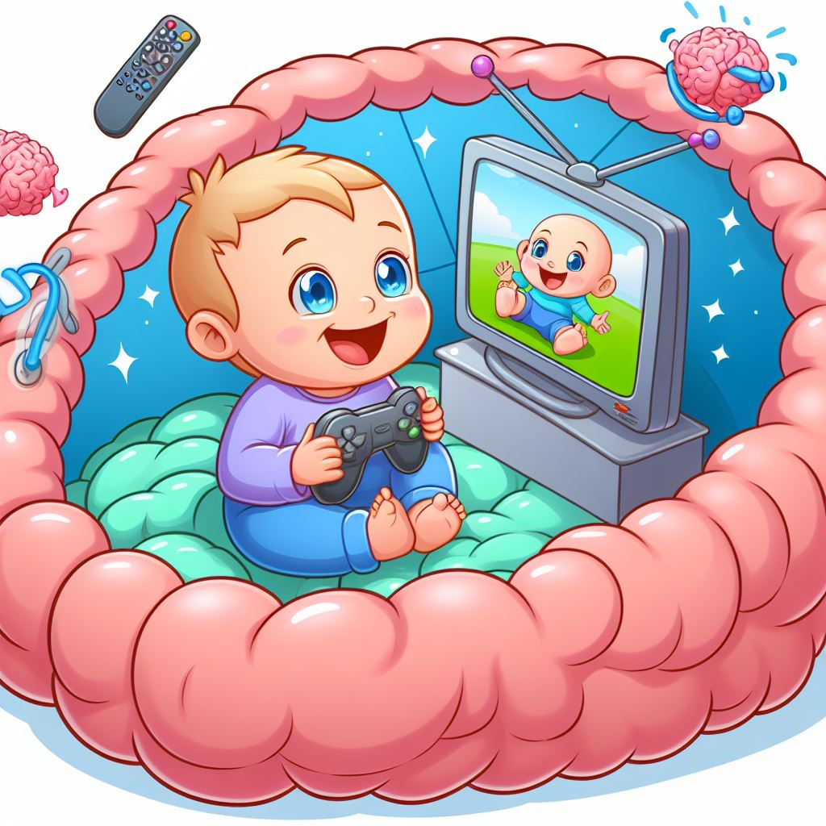
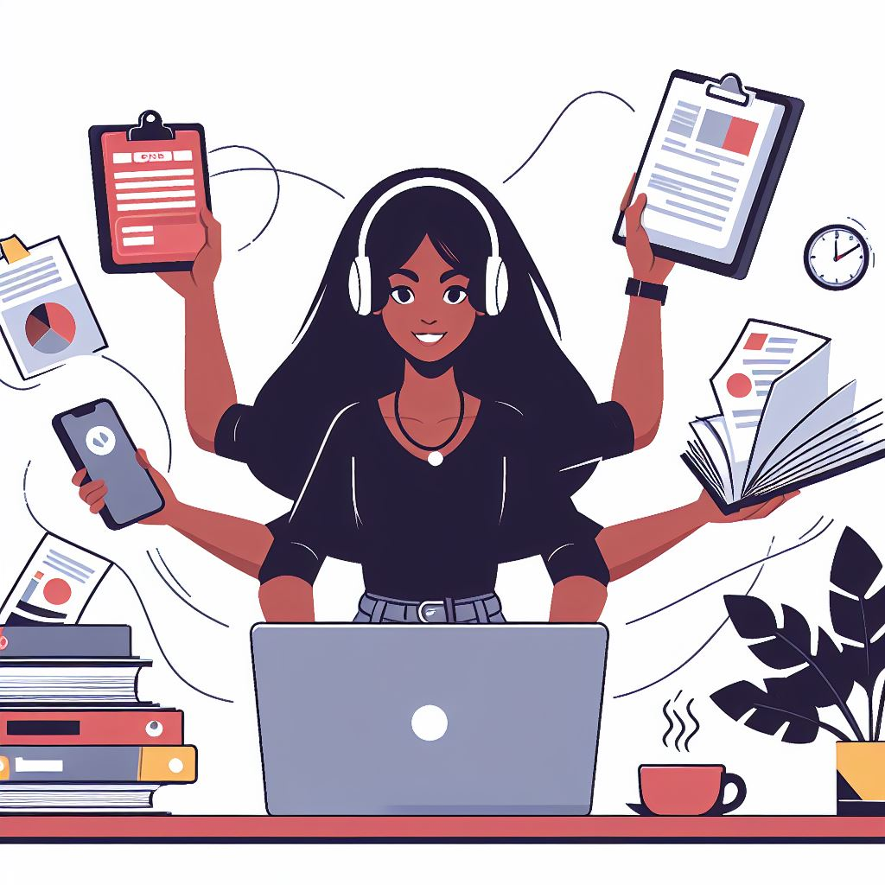
Interest
Importance-based vs interest-based nervous system
Distract the toddler
Dual-tasking
Notes:
For a neurotypical person, the very fact that a task is important is often enough for them to have the motivation to get it done – they have an importance-based nervous system. Generalisation but often true. This isn’t the case with neurodivergent brains, who have an interest-based nervous system. They need to find a task actively interesting to find motivation to complete it – it being important isn’t enough for us to find the motivation to complete it.
Brain hacks to keep you interested in a task basically revolve around distracting the toddler. This is effectively keeping half of my brain distracted with something, whilst the rest of my brain can focus on the task at hand. Music work the best for me, I listen to music pretty much 24/7, but watching a TV show or film works too.
Similarly, dual-tasking works well. This can tie into something like listening to music, but can also refer to bouncing between tasks, or even multi-tasking. I will often have a different task on each monitor, that need different levels of focus – I’ll be doing an admin-based task whilst problem solving, helping keep my interest on both tasks.
In terms of being non-technical, there is constant learning in a job like marketing – not only to learn about how to market specific things, but also to keep on top of the tech itself. As someone who naturally loves learning, this is a source of interest for me.

Slide 8
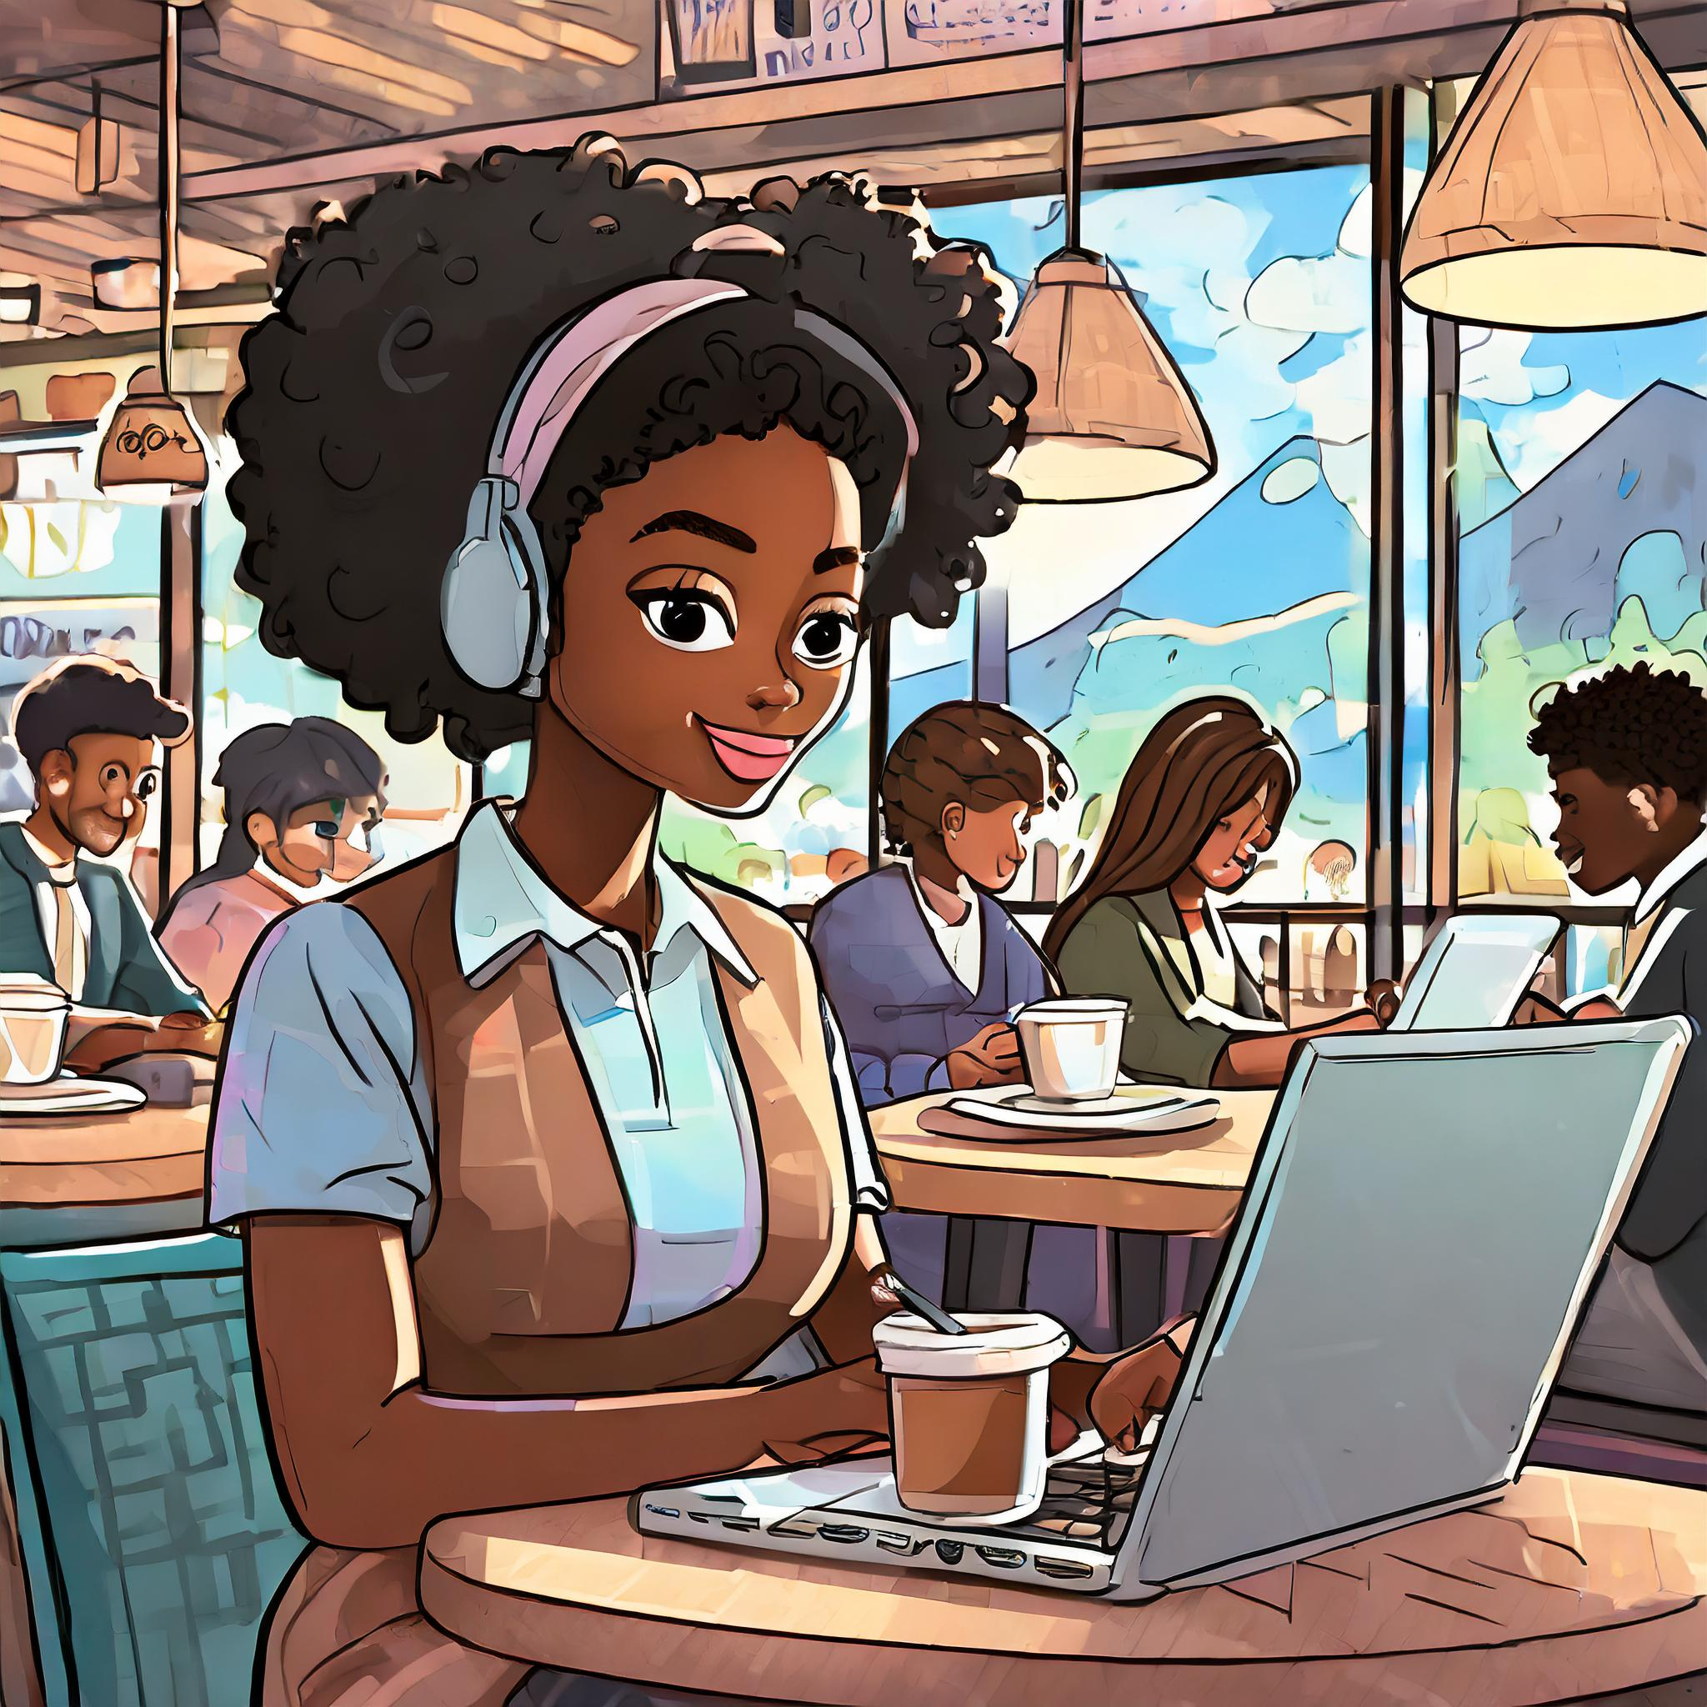

Novelty
ADHDers are drawn to new shiny things!
Change up your routine
Bounce between tasks
Notes:
On to Novelty – ADHDers are drawn to nice new shiny things! We are like magpies. As the shine wears off, so does our motivation. This is one of the reasons the those with ADHD statistically struggle to hold down a job. We’re also naturally very impulsive – as our brains have lower levels of dopamine, we’re effectively hunting for our next dopamine hit, which leads to impulsive decisions as we want that newness and novelty.
But, this can be harnessed into something good. Changing up my routine or where I work is a sure-fire way to increase my productivity. If I have something I need to get done, I’ll go to a coffee shop for an afternoon, and will be 10 times more productive. Sometimes I’ll move from my desk to my sofa, literally two steps away, but it’s enough novelty to kick my brain into gear.
A crossover with interest here is bouncing between tasks. This will vary hugely between neurodivergent people – those with autism often find context-switching difficult, so they may not benefit from a hack like this. But for me, switching between tasks makes it novel every time, and brings a sense of newness.
Being in marketing is also perfect for this, particularly as a one-person team, as every day is different – literally. Combined with the constant learning, it gets very fast-paced, which I love.

Slide 9
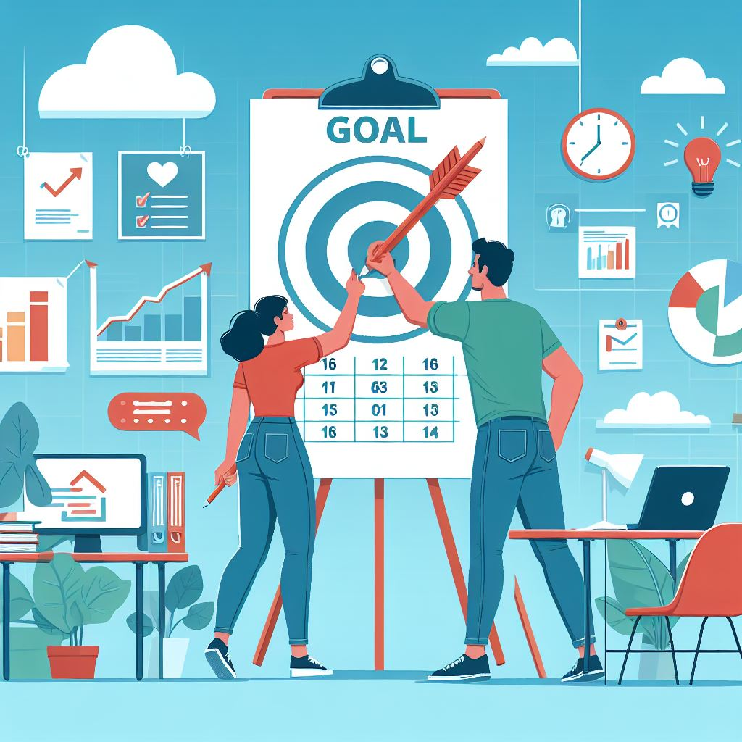
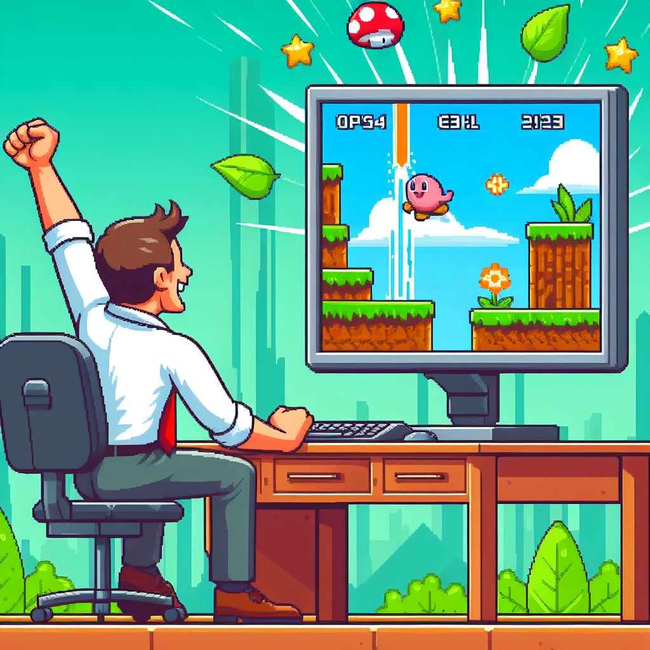
Challenge
We’re easily bored, even if the work isn’t boring
Consistent goal setting
Game-ify everything
Notes:
With challenge, the idea is that people with ADHD are easily bored. Our brains are literally wired differently, so things that would catch a neurotypical person’s brain for a good while, will hold our attention for far less time. Even if I know that the work I’m doing isn’t boring, and that I enjoy it, I need to be challenged in order to get fulfilment out of it.
Rather than a quick fix, this is a longer brain hack – but consistent goal-setting and reflection massively helps. Being able to see what goals I’ve hit and reflect on those gives me the motivation and want to continue being challenged. This also gives you a chance to check in with your manager, to see if you’re being challenged the right amount, and means you can adjust it if need.
In terms of the challenges themselves, to make something normal more challenging, I highly recommend game-ifying things. This will look different for each person and what their work looks like, but reward systems and ‘beat-the-time’ systems both work well for most tasks.

Slide 10
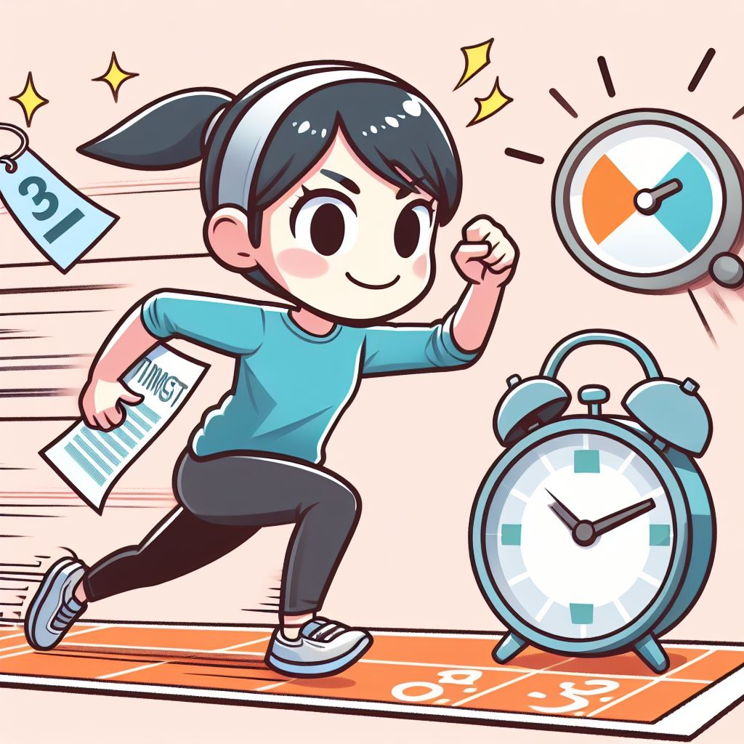
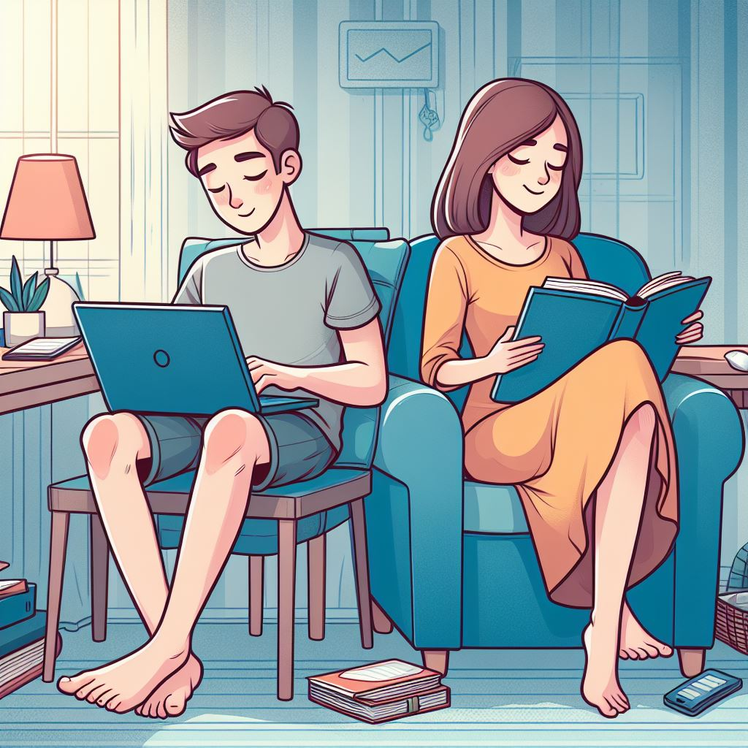
Urgency
Tendency to leave things to the last minute – if there is no ‘last minute’, it just won’t get done.
Set deadlines
Body doubling
Notes:
Urgency is the one that has the biggest impact for me personally. ADHDers have a tendency to leave things to the last minute, to get a rush of adrenaline – and therefore dopamine – required to complete the task. If there’s no ‘last minute’, it just won’t get done. That sense of pressure, although it sounds negative, is needed to give me motivation to get a task done.
Naturally, deadlines are needed to have a sense of urgency, particularly when someone is keeping me accountable. If the deadline is short (ie. When I give myself 10 minutes to get something done), I don’t use a timer, because I know that traditional timer sounds don’t work for me, they’re too normal. Instead, I decide on a completely ridiculous song as my timer sound, or will queue up songs to match the length of time I’ve given myself, ending with that song. This means that I regularly rick-roll myself, but it’s very effective!
Body doubling is the other hack I use daily. This is where you have someone with you, either physically or virtually, to keep you on track. They don’t need to be working, and don’t even need to necessarily know they’re body doubling with you – for e.g. when I’m in a coffeeshop, part of the reason it work is because of all the people around. It adds a sense of pressure that I need to stay motivated. If body doubling isn’t possible for you, the next best thing is to film yourself. I’ll set my phone up on the timelapse function, which stops me from picking up my phone, plus I get a sense of satisfaction when I watch it back.

Slide 11
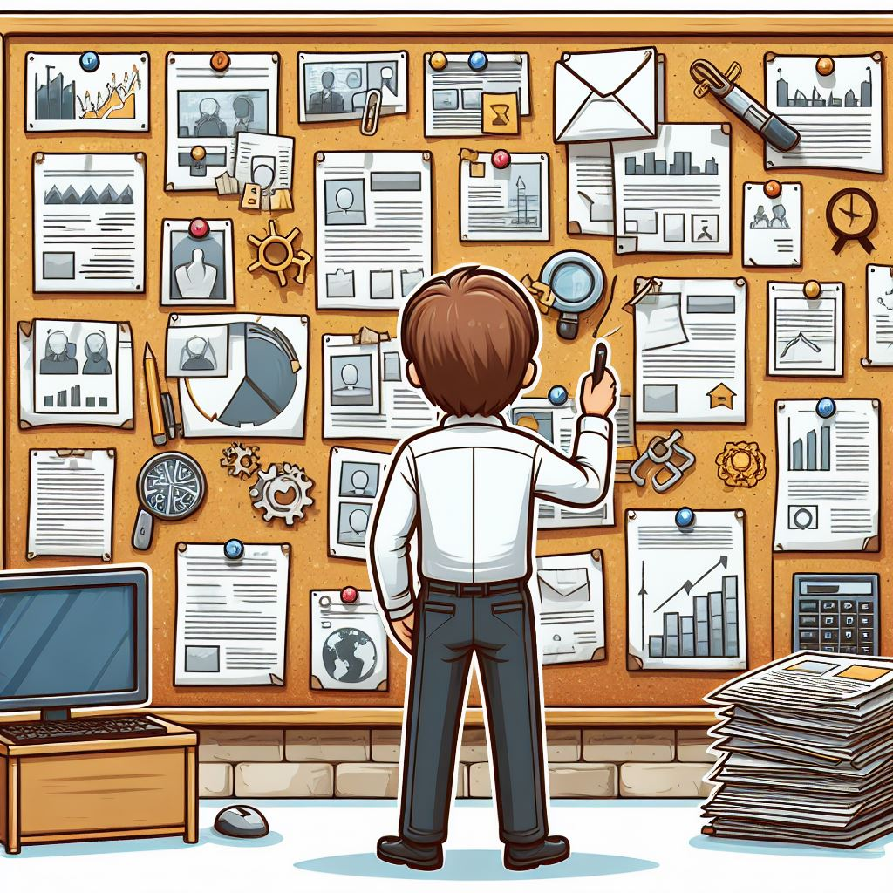
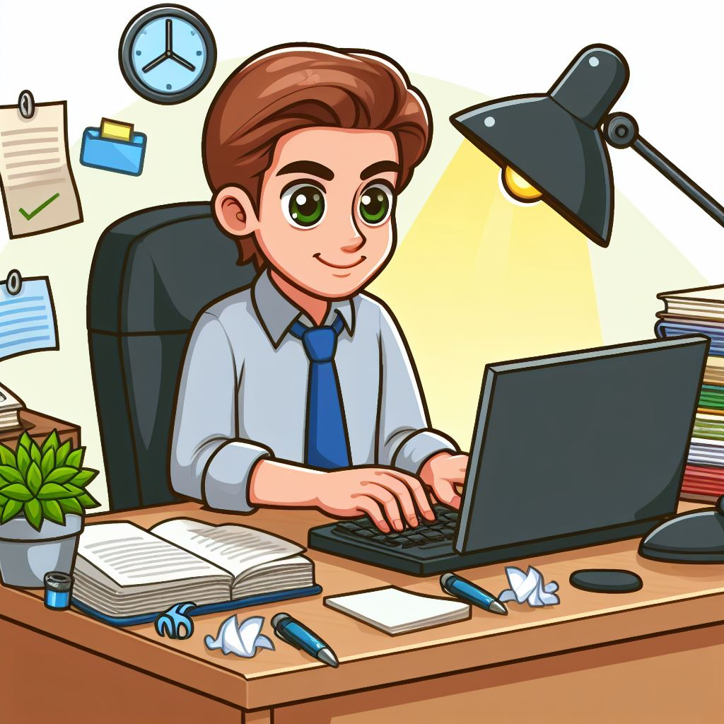
Passion
It’s either there or it isn’t – but it does ebb and flow
Owning a project
Hyperfocus
Notes:
Passion is a tricky one. In my experience, it’s either there or it isn’t, and tends to exist around very specific things. But, it does ebb and flow, and there are things you can do to increase the level of passion. Obviously, there is a big overlap with interest.
Having ownership of a project is one thing that can help – this takes into account a lot of the other brain hacks, like goals and deadlines, and gives the satisfaction of finishing a project – something which many people with ADHD struggle to do.
Hyperfocus can both be a way to create passion and is also the outcome of passion, which makes it incredible valuable. It’s similar to ADHD paralysis in the sense that I might forget to eat or move from my desk, but instead of being stuck doomscrolling, I’m working. I’ve timed myself a lot in past year or so, and a task that might take 2 or 3 hours ordinarily, can take an hour in hyperfocus – which is a huge difference! Hyperfocus generally only happens when I’m passionate about something, but there are ways to get myself into that flow state – things like specific genres of music like film scores, having a specific drink, or a change of scenery, all help.

Slide 12
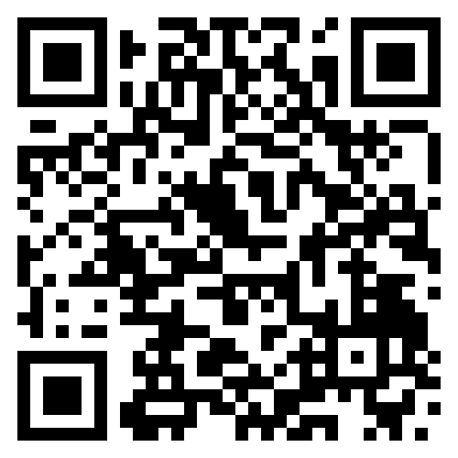
Key takeaways
Working with my brain, not against it.
ADHD is a disability, and should be treated as such.
Fave brain hack:
Game-ify everything
Deadlines
Resources:
r/ADHD
Ella Willis (they/them)
Ellie Middleton (she/her)
Check out our Careers page!
Notes:
So – my key takeaways. Working with my brain and not against it was an absolute gamechanger for me. Understanding what works for me and being able to ask my manager for accommodations in a non-judgemental environment has genuinely changed my life. Being able to show up at work and say I’m struggling and be met with compassion and problem solving rather than being reprimanded like I’ve heard others in the neurodivergent community having, is incredible. The understanding, both from myself and my employer, that ADHD is a disability, and does undoubtedly affect all areas of my life, has led me to being the happiest and most productive I’ve ever been. It’s enabled me to harness the amazing parts of ADHD without the risk of burning out and with complete acceptance of those around me.
In terms of the actual brain hacks, game-ifying tasks and setting deadlines are the two that made the biggest difference to my motivation and productivity. Obviously, they may not work for you, but I’d encourage you to try them, and experiment with other hacks. I highly recommend the ADHD subreddit, it’s surprisingly well organised and you can generally search for what you want in it.

Slide 13
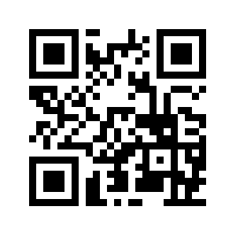


Feedback
Please provide feedback!
www.linkedin.com/in/isi-turner
isi@advancinganalytics.co.uk

